Slide 1
Grouping of Non-Daily Trains into Daily Trains
Abijith P. Y. (203190024)
Sajith Menon (203190025)
Zubeen Kishore Borkar (203190026)

Slide 2
Acknowledgement
We are thankful to Prof. Narayan Rangaraj (IEOR) and Prof. Madhu N Belur (EE) for giving us this opportunity to work on this project and for their suggestions.
We also thank Prof. Amit Sethi for insightful discussion and suggestions regarding the project.

Slide 3
Introduction
Golden Quadrilateral routes accounts for majority of traffic in Indian Railway
Optimizing train schedule in this route is very beneficial for Railways and General Public
Clustering of Non-daily trains in Quadrilateral routes was performed based on traffic coverage
Clustering was done on this two routes MMCT-NDLS and MAS-NDLS
By using the method we propose,we could optimize train schedule in this route.
Used K Means Clustering Algorithm to cluster our result based on station traversed
Used Weekday Complimentary Algorithm to further group our train to form a dailyzing or near daily schedule.
Finding optimal parameter for dialyzing path was challenging.Some trains only travels 1 or 2 station in our route and Some does not form a dailyzing path

Slide 4
Previous work
Used Excel and manual methods to achieve objective
Needed a lot of manpower to complete the task
Had human errors and was a cumbersome process
This method worked only for given route and not in general, so for new route they needed to follow the same process which is not an efficient way of working as it is time consuming and has human errors.

Slide 5
K - means / clustering
K - means Clustering is simple and it is an unsupervised ML algorithm
K-means works by partitioning observation to cluster with nearest centroid
Centroid gets Updated on each iteration.
Hyperparameter used in K-means is number of clusters.
Optimal Clusters can be found using Silhouette Score , Elbow Method etc..
We initially tried Silhouette Score to find out optimal Cluster,
It was taking lot of time to execute and was difficult to make out optimal cluster from Silhouette Score Method.
We then used Kneed package to find out best hyperparameter(number of clusters)

Slide 6
Implementation
Approach 1 :
We have 5 stations namely A, B, C, D, E, and two trains name train 1 and train 2.
Let train 1 travels from A-B-C and train 2 travels from C-D-E so according to our logic we will show them as
Train number COABLCKSCTN A B C D E
Train 1 A-B 1 1 0 0 0
Train 1 B-C 0 1 1 0 0
Train 2 C-D 0 0 1 1 0
Train 2 D-E 0 0 0 1 1
Doing so helps us to get an idea of the sequence of stations visited by trains. But when we tried implementing this logic using K-means algorithm, we obtained poor results.

Slide 7
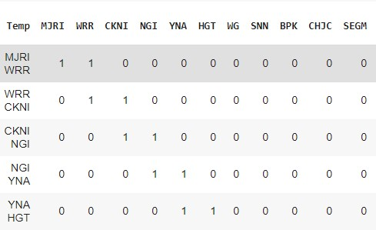
Implementation
Approach 1 dataset :

Slide 8
Implementation
Approach 2 :
Generated a specialized class called “Train” which stored the necessary data required for each train id as it’s properties
Start station & end station,
stations involved in it’s journey,
weekdays it is travelling and
direction it travelled
All of the objects of this class are defined using the Train ID.
Entire dataset was reduced to very less yet unique data points

Slide 9
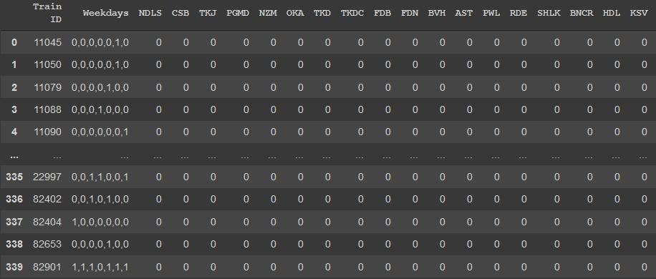
Implementation
Approach 2 dataset :

Slide 10
Implementation
Complimentary weekdays algorithm on clustered trains
We want the maximum utilization of route, so we make pairs of trains such that they run on different days but their departure timing should have a difference of 20 minutes at max (we need to find out such combinations). To implement this logic, we use the following algorithm whose logic is explained below
Train number Weekdays Weekdays compliment Combination
Train A 1 1 0 0 0 0 0 0 0 1 1 1 1 1 (B,3) , (C,5)
Train B 0 0 1 0 0 0 0 1 1 0 1 1 1 1 (A,3) , (C,4)
Train C 0 0 0 1 1 1 0 1 1 1 0 0 0 1 (A,5) , (B,4)
We try to compare Train A’s weekday compliment column with the weekdays of other trains. After comparing, we write the number of elements matched in the combination column. This algorithm gives us the correct combination of train pairs A and C (as C has 5 elements).

Slide 11
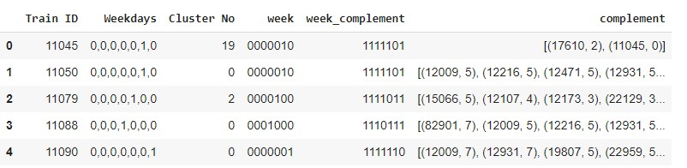
Implementation
Complimentary weekdays algorithm on clustered trains data set

Slide 12
Results
Initial Clusters - formed using an unsupervised learning algorithm viz. K-Means algorithm
Clusters formed are further clustered using a custom algorithm made by us
Clusters are formed such that trains with around 70% similarity , as well as those that aren’t travelling on the same date are in the same cluster
This helped to detect days in which the route is free and can optimize the timetable based on the clusters formed
Assumption:
Route is fully utilized when the time between 2 trains is less than or equal to 20 minutes

Slide 13
Future work
Improvement may be seen on further research on choice of clustering statistic & also on the choice of the parameters might be supported by advanced techniques and metrics
Neural network based feature extraction than a manual method can improve the efficiency of the algorithm
RL based approach can also be implemented along with this which increases the usefulness of clusters even more

Slide 14
Future work
Trains that are on the same day but on non intersecting time frames can be clustered together which isn’t considered in our clustering methods
Further enhancement on cluster inference can also be made by identifying new clustering metrics between observations or by integrating additional sources of information

